Slide 1


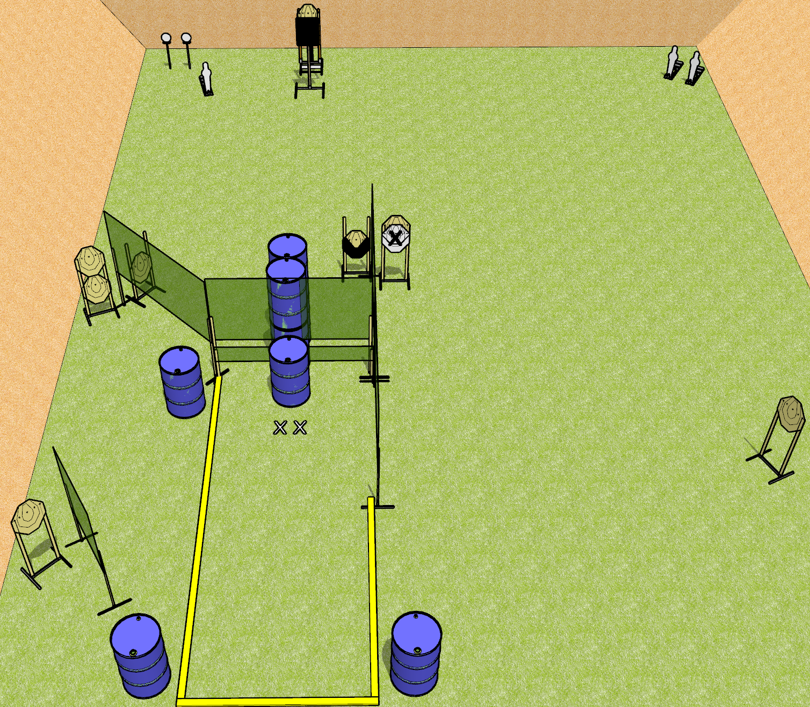
 | Dothan Gun Club – USPSA Match This Will Only Take a Moment Course Designer : Drew Coleman
Round Count 29 rounds 8 IPSC 3 minis, 2 plates
Equipment List 9 wall feet The tall port wall and the low wall to go with it Bobber + activator + steel challenge plate

Slide 2
This Will Only Take a Moment
Written Stage Briefing
This Will Only Take a Moment is a 29 round, 145 point, Comstock course of fire. There are 8 IPSC targets, 3 mini poppers, and 2 falling plates. The best 3 hits on paper will score, and steel must fall to score. The start signal is audible.
The bobber is activated by the leftmost mini popper, and remains visible at rest. It must be activated before being engaged.
Rule 8.2.3/8.2.3.1 – you may not touch a firearm or magazine after standby and before the start signal.
Start position is both feet on X’s, palms flat on barrel. Firearm is unloaded on any barrel. All magazines to be used on stage are on any other barrels. No magazines may be on the same barrel as the firearm.
On start signal, engage targets as they become available from within the shooting area.

